Slide 1
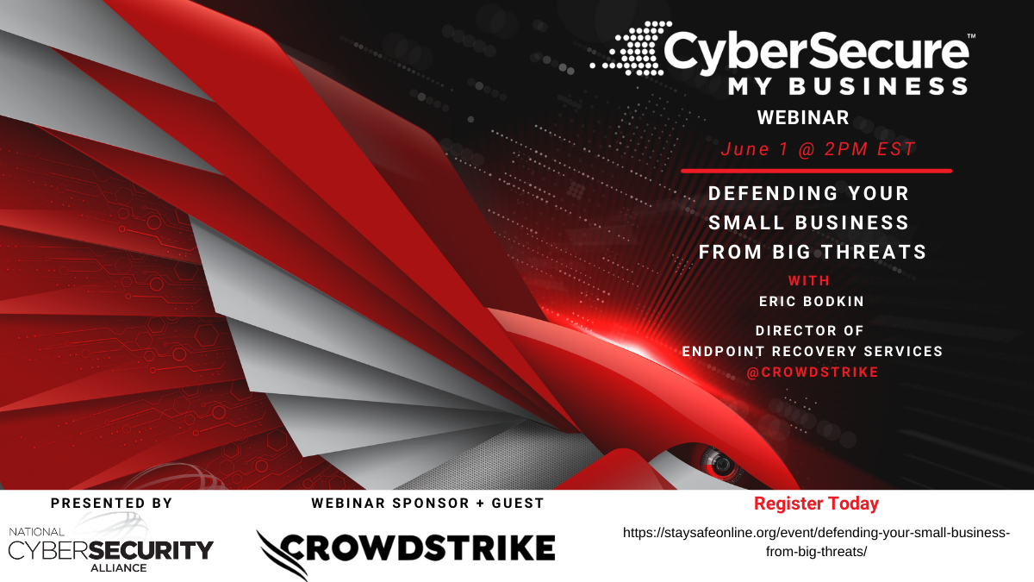

Slide 2



Follow us on Twitter
@staysafeonline
Visit us online at
staysafeonline.org
Convening partners who recognize strength in the security collective
Educating individuals and organizations on cybersecurity best practices
Amplifying collective efforts to increase cybersecurity awareness

Slide 3
Thank you to our national sponsors.
Signature Sponsor
Contributing Sponsor
Affiliate Sponsor
Webinar Sponsor
2021 Sponsorships Available
info@staysafeonline.org
2 slots available
3 slots available
3 slots available
Unlimited availability
Our sponsors help us reach
Over 10K webinar attendees
Over 5K workshop attendees
Over 15K subscribers

Slide 4

Defending Small Businesses from Big Threats

Slide 5
Our Speakers
Eric Bodkin
Director of Endpoint Recovery Services
  Leader
  Veteran
  Experienced:
    incident response
    forensic investigation
    threat hunting
    running managed detection/response teams
Bradford Willke

Slide 6
Cybersecurity Risk for small business
Defending your small business from big Threats

Slide 7
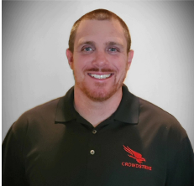
Today’s Speaker
Eric Bodkin is the Director of Endpoint Recovery Services at CrowdStrike.
Eric has more than 12 years of experience in incident response, forensic investigation, threat hunting, and building and running managed detection and response teams.
At CrowdStrike, Eric leads service engagements focused on recovery and remediation of endpoints in response to a cyber incident, helping businesses rapidly return to operations post-breach.
Prior to joining CrowdStrike, Eric was a Senior Manager for a Big 4 consulting firm and is a military veteran of 9 years.

Slide 8
Agenda
Cyber Threats & Small/Medium Business
Myths & Misconceptions
Real-World Attack Lifecycle & Small Business Impact
How Can Falcon & CrowdStrike Help

Slide 9
Small business Threats, Myths,& Misconceptions

Slide 10
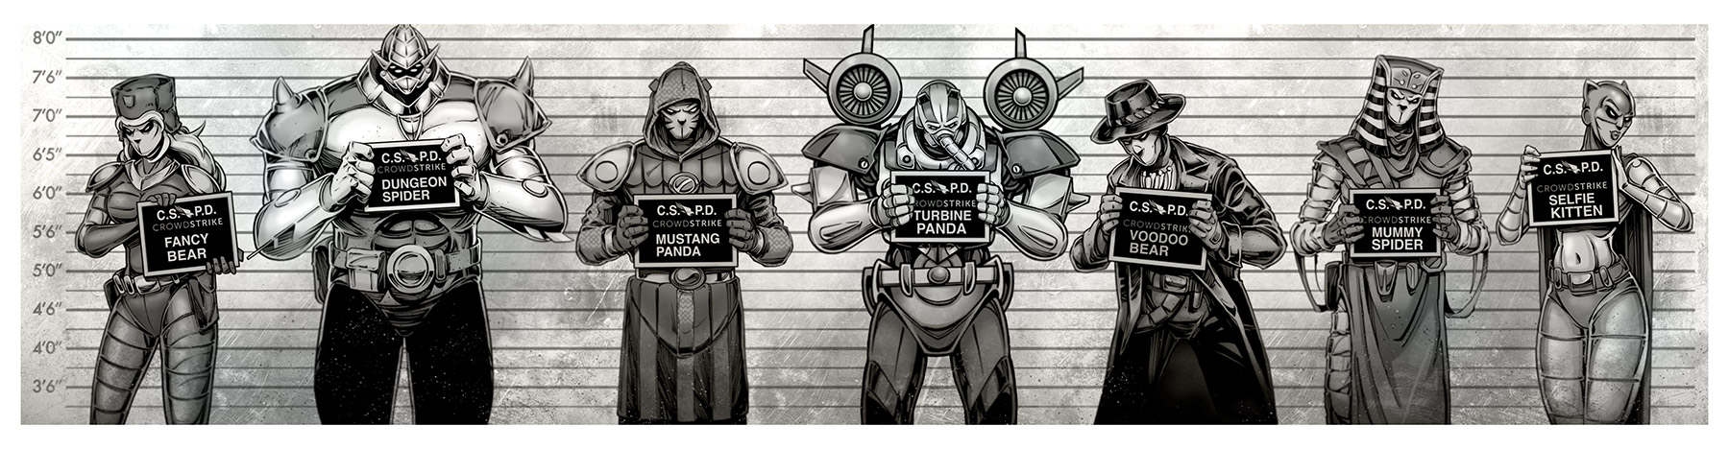
THE adversaries
150+ active adversary groups tracked across the globe
CROWDSTRIKE FALCON PLATFORM
700+ BILLION SECURITY EVENTS PER DAY 140+ MILLION IOA DECISIONS PER SECOND 75,000+ BREACHES STOPPED PER YEAR
Notes:
The global threat landscape is surrounded by sophisticated groups of adversaries using advanced techniques to launch targeted attacks on businesses just like yours.
We have attributed attacks to more 150 adversary groups across the globe, with the CrowdStrike Falcon platform analyzing more than 700 billion security events every single day. Yes, 700 billion with a B…every single day.
Our platform uses advanced machine learning and threat intel to analyze these events making 140 million IOA decisions every second to quickly identify and stop breaches before they disrupt your organization.
We stop more than 75,000 breaches a year for our clients who place their trust in CrowdStrike to protect their business.

Slide 11




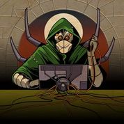

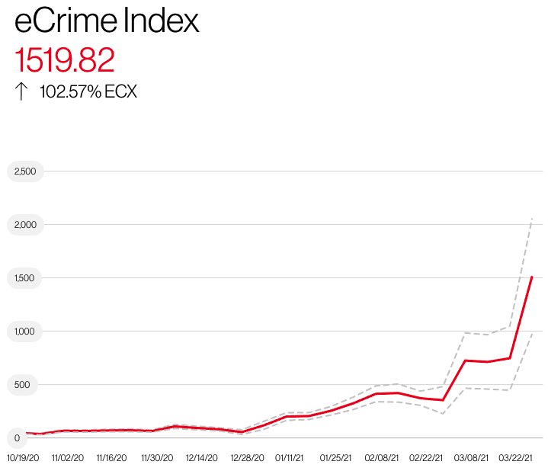




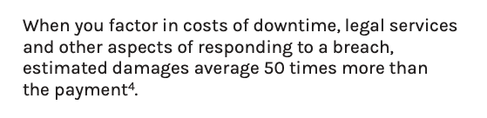

Meet your adversaries
Dungeon Spider
Cobalt Spider
Wizard Spider
Twisted Spider
Pinchy Spider
Doppel Spider
Breaches are on the rise
Motives & Opportunity
Small business impact
2021 CROWDSTRIKE, INC. ALL RIGHTS RESERVED.
Notes:
From the last slide – SMB doesn’t face a Bear, Panda, or Kitten problem – they face a Spider problem. This slide introduces them to Spiders as the threat and aligns to Pg. 3 & 4 of the ebook.

Slide 12
Common Myths & Misconceptions
MYTH #1
“I’m not a Target”
MYTH #2
“I’m Protected”
MYTH #3
“I can bounce back”
Truth: Your size , revenue, and business purpose don’t make you a TARGETED entity
Truth: Most small businesses deploy traditional Anti-Virus, Firewall, VPN, and other common security products
Truth: Smaller, more centralized environments have the potential for more rapid recovery
Truth: Your probable lack of dedicated, security-focused people, processes, and technology make you a TARGET
Truth: Most small businesses lack the resources and expertise to maintain and optimize these platforms nor properly action alerts when they do occur
Truth(s): Threat Actors take many steps to thwart the recovery process and solicit/monetize demands. Smaller interruptions can lead to larger impact for small businesses
2021 CROWDSTRIKE, INC. ALL RIGHTS RESERVED.
Notes:
Aligns to pg 5 & 6 of the ebook
Myth #1 supplement discussion thoughts:
Provide numbers around how many ERS engagements are less than < 1000 endpoints.
Share actual data from the eBook or other sources regarding SMB impact from cyber crime
Myth #2 supp:
Dialogue around how small business has trouble managing, maintaining, and optimizing these products (i.e. vulnerabilities and ERS anecdote)
Dialogue around how the lack of a security experts often leads to the incorrect identification and eradication of these threats even when the product works as advertised (ERS anecdote)
Myth #3 supp:
Dialogue around general tactics that the TA takes with respect to data and backup deletion, exifil and extortion, etc
Dialogue about while the recovery of data might be straightforward (might) that data exposure and extortion lead additional legal, insurance, and regulatory costs, much less the unknown quantitative costs of brand and customer impact due to the incident
Most large customer can absorb these impacts. Tell some ERS

Slide 13
The attack lifecycle and why small businesses struggle

Slide 14
Common Ransomware ATTACK CHAIN
12
Initial Access | Lateral Movement | Execution | Persistence | Impact
Account/RDP Brute Force | WMI | Cobalt Strike | Scheduled Tasks | BitPaymer Ransomware
Internet Exposed Vulnerabilities | PSEXEC | Powershell Empire | Persistent Service Creation | Ryuk Ransomware
Phishing / Social Engineering | Remote Service Creation | TA-Specific Loaders/Trojans | GPO Configuration | GandCrab Ransomware
11
10
9
MITRE ATT&CK PHASE
8
1
2
3
4
5
6
7
Initial Access
Execution
Persistence
Privilege Escalation
Defense Evasion
Credential Access
Discovery
Lateral Movement
Collection
Exfiltration
Command & Control
Impact
Notes:
The purpose of this slide is not to fully educate or get into the weeds of the attack chain but to introduce the concept of the next few slides, reinforce the ”myths”, and how it’s difficult for small business to mitigate the risk
Quick synopsis of threat actors

Slide 15
Accelerating Threat Landscape
UBIQUITOUS TARGETED THREATS
Threats as a Service
AUTOMATED THREATS
Attack toolkits
OPPORTUNISTIC THREATS
Cyber warfare
Ransomware
Viruses
Trojans
DDoS
Phishing
ATTACK VOLUME AND VELOCITY
APTs
Worms
Botnets
1990
2000
2010
2020
WEEKS OR MONTHS TO RESPOND
DAYS TO RESPOND
HOURS TO RESPOND
MINUTES TO RESPOND
24 HOURS/DAY
7 DAYS/WEEK
365 DAYS/YEAR

Slide 16


preventing breaches
What’s Needed
TECHNOLOGY
Complete visibility across attack surfaces
  Network
  Endpoints/Assets
  Email
  Cloud
Highly-effective detection and prevention
Maximizes the People and Process components
PROCESSES
PEOPLE
16
2021 CROWDSTRIKE, INC. ALL RIGHTS RESERVED.

Slide 17

preventing breaches
What’s Needed
IT and security technology enabled and optimized
Corporate security policies implemented and validated
Incident Response planning and execution
TECHNOLOGY
PROCESSES
PEOPLE
17
2021 CROWDSTRIKE, INC. ALL RIGHTS RESERVED.

Slide 18

preventing breaches
What’s Needed
TECHNOLOGY
Drives, operates and enforces Technology and Processes
Must be knowledgeable, experienced, and effective
PROCESSES
PEOPLE
18
2021 CROWDSTRIKE, INC. ALL RIGHTS RESERVED.

Slide 19

Preventing Breaches
Challenges to Small Business
TECHNOLOGY
PROCESSES
PEOPLE
Incomplete visibility across
  Network
  Endpoints/Assets
  Email
  Cloud
Less-than-optimal solutions where they do exist
Limits People and Processes
Unoptimized IT and security systems
Outdated corporate security policies
Ineffective or untested Incident Response planning
Limited resources
Business hours coverage
Less experienced
Lots of hats, lots to do, not enough time in the day
2021 CROWDSTRIKE, INC. ALL RIGHTS RESERVED.

Slide 20

Real-world small business examples
3 out of 1000’s
EMOTET & TRICKBOT
Ransomware - REVIL
Ransomware - RYUK
Initial Access: Phishing document from trusted contact
Lateral Movement: 400+ endpoints infected with Emotet and TrickBot
Existing AV failed to detect/prevent behavior
Detected behavior by “accident”
Initial access to Full Compromise: Less than 24 hours
Narrowly escaped ransomware event
Initial Access: 2 year old, unpatched vulnerability in Pulse VPN
Existing AV failed to detect/prevent behavior
Collected 1 TB of sensitive data including PII
Encrypted 300 endpoints and backup server
Significant business downtime, ransom demands with extortion, costly legal/regulatory requirements
Initial Access: Phishing document from trusted contact
Lateral Movement: Cobalt Strike and/or Ryuk execution on more than 200 endpoints
Existing solution detected malicious behavior post-phish – IT team failed to effectively mitigate risk
Initial access to full domain ENCRYPTION – 45 minutes
MSP – massive business impact internally and to their clients
2021 CROWDSTRIKE, INC. ALL RIGHTS RESERVED.

Slide 21
How Falcon & crowdstrike can help

Slide 22







TECHNOLOGY
FALCON PLATFORM
100% CLOUD NATIVE
No infrastructure to deploy
No hardware to maintain
Ready from day one
Scalable
PROPRIETARY THREAT GRAPH
15+ petabytes of security telemetry data in the cloud
700b+ security events processed per day
140m+ IOA decisions made per second
75,000+ breaches stopped per year
150+ adversaries tracked across the globe
SINGLE LIGHTWEIGHT AGENT
Protection on- and off-line
Low overhead
No reboots
Deploy in one day
Endpoints, servers, cloud, VMs, containers
Notes:
Dive into feature and capabilities of the bundles

Slide 23





Processes
Requires more than just technology
MANAGE
IMPLEMENT
  CONFIGURE
  TUNE
PREVENT
BLOCK THREATS
MONITOR
DETECT
PRIORITIZE
INVESTIGATE
RESPOND
CONTAIN
  REMEDIATE
2021 CROWDSTRIKE, INC. ALL RIGHTS RESERVED.
Notes:
Most organizations focus on prevention, or security as a project. Mature organizations understand that it’s a continuous process, that relies not just on technology, but also people and process.
Most organizations under invest in the people and process.

Slide 24

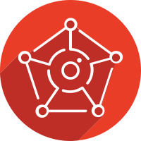


People
Effective Monitoring & Response
FALCON
COMPLETE
24X7 CONTINUOUS MONITORING & RESPONSE
 | Industry Average * | Continuous Monitoring & Response
Time to Detect | 120 Hours | 1 Minute
Time to Investigate | 11 Hours | 6 Minutes
Time to Remediate | 31 Hours | 29 Minutes
CROWDSTRIKE INTELLIGENCE
UNDERSTAND YOUR ADVERSARIES
FALCON OVERWATCH
24X7 THREAT HUNTING
* Source: CrowdStrike 2019 Global Security Attitude Survey
FALCON COMPLETE EXCEEDS THE 1:10:60 GOAL
2021 CROWDSTRIKE, INC. ALL RIGHTS RESERVED.
Notes:
The key metric in effectively dealing with attacks is the time it takes to remediate. Effective response and remediation of a threat first requires detecting the threat, then performing the investigation to scope and understand it, and finally taking action to remediate the threat. Of course, while the defenders are executing this playbook, adversaries are not standing still and bigger, faster, stronger always wins.
In a fight, the best defense is to not be there. Unfortunately that’s just not practical here. But what is practical, is our fully managed 24/7/365 continuous monitoring, response, and remediation offering called Falcon Complete. Looking at the chart in the slide, the average industry times pale in comparison to the average Falcon Complete times. This type of continuous monitoring, response, and remediation certainly is a game changer, and allows our customers to sleep better at night, and ultimately avoid having to call our IR team.

Slide 25
Final Myth & Misconception
MYTH #4
“Of course, I’d love the solution, but it’s unattainable”
Truth: Nearly every small business has constraints, especially budgetary, compared to larger corporations
Truth: Cost is relative to size, but the impact is even greater. A solution like Falcon Complete is attainable for small businesses
2021 CROWDSTRIKE, INC. ALL RIGHTS RESERVED.
Notes:
Aligns to pg 5 & 6 of the ebook
Myth #1 supplement discussion thoughts:
Provide numbers around how many ERS engagements are less than < 1000 endpoints.
Share actual data from the eBook or other sources regarding SMB impact from cyber crime
Myth #2 supp:
Dialogue around how small business has trouble managing, maintaining, and optimizing these products (i.e. vulnerabilities and ERS anecdote)
Dialogue around how the lack of a security experts often leads to the incorrect identification and eradication of these threats even when the product works as advertised (ERS anecdote)
Myth #3 supp:
Dialogue around general tactics that the TA takes with respect to data and backup deletion, exifil and extortion, etc
Dialogue about while the recovery of data might be straightforward (might) that data exposure and extortion lead additional legal, insurance, and regulatory costs, much less the unknown quantitative costs of brand and customer impact due to the incident
Most large customer can absorb these impacts. Tell some ERS

Slide 26
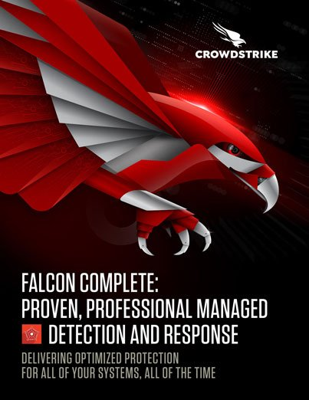
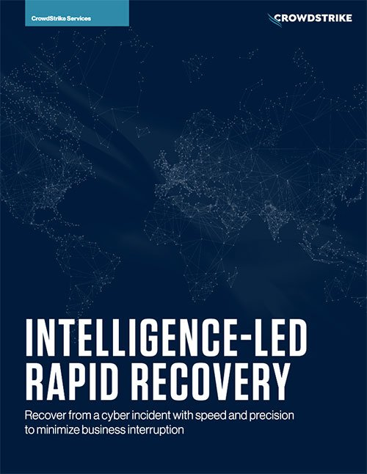
QUESTIONS & Additional resources
Additional resources:
Q&A
Learn more at www.CrowdStrike.com
https://www.crowdstrike.com/resources/white-papers/ransomware-realities-for-small-and-medium-sized-businesses
https://www.crowdstrike.com/resources/white-papers/the-secret-to-cybersecurity-for-small-businesses
https://www.crowdstrike.com/resources/white-papers/falcon-complete-managed-detection-and-response
https://www.crowdstrike.com/resources/white-papers/intelligence-led-rapid-recovery
2021 CROWDSTRIKE, INC. ALL RIGHTS RESERVED.
Notes:
https://www.crowdstrike.com/resources/white-papers/ransomware-realities-for-small-and-medium-sized-businesses/
https://www.crowdstrike.com/resources/white-papers/the-secret-to-cybersecurity-for-small-businesses/
https://www.crowdstrike.com/resources/white-papers/falcon-complete-managed-detection-and-response/
https://www.crowdstrike.com/resources/white-papers/intelligence-led-rapid-recovery/

Slide 27
THANK YOU
Notes:
Thank you

