Slide 1
How to Get Involved in​
Data Privacy Week 2024​
Lisa Plaggemier​
EXECUTIVE DIRECTOR
National Cybersecurity Alliance​
Notes:
I START – no introduction from Lucas​

Slide 2
Board Members

Slide 3
Agenda
HOW TO GET INVOLVED IN​ DATA PRIVACY WEEK 2024​
01
About Data Privacy Week
02
Take Control of your Data
03
How to Get Involved
04
Upcoming Events
05
Additional Resources

Slide 4
It will be uploaded to staysafeonline.org ​
PLEASE NOTE…
This webinar is being recorded
Presentation slides will be made available to download​
Please use the Q&A chat box to ask any questions​
Notes:
Is available now to download and it will be in the post webinar email

Slide 6
ABOUT US
We empower a more secure, interconnected world.
Our alliance stands for the safe and secure use of all technology.
We encourage everyone to do their part to prevent digital wrongdoing of any kind.
We build strong partnerships, educate and inspire all to take action to protect ourselves, our families, organizations and nations.
Only together can we realize a more secure, interconnected world.
HBCU Career Program

Slide 7
01
About Data Privacy Week​

Slide 8
ABOUT DATA PRIVACY WEEK​
Data Privacy Week Overview​
Expansion of Data Privacy Day.​
Spreads awareness about online privacy
Began in the United States and Canada in January 2008 as an extension of Data Protection Day in Europe. ​
Educates citizens on how to manage their personal information and keep it secure.
Commemorates the Jan. 28, 1981 signing of Convention 108, the first legally binding international treaty dealing with privacy and data protection. ​
Encourages businesses to respect data and be more transparent about how they collect and use customer data.

Slide 9
02
Data Privacy Week 2024 Theme:
TAKE CONTROL OF YOUR DATA

Slide 10
TAKE CONTROL OF YOUR DATA
Steps to Take
01
Know the tradeoff between privacy and convenience
02
Adjust privacy settings to your comfort level
03
Protect Your Data

Slide 11
TAKE CONTROL OF YOUR DATA
Know the privacy/convenience tradeoff
Consider the amount of information they are asking for. Weigh it against the benefits you may receive in return.
Make informed decisions about sharing your data with certain businesses.
Be wary of apps or services that require access to information that is not relevant to their services.
Delete unused apps

Slide 12
TAKE CONTROL OF YOUR DATA
Adjust privacy settings to your comfort level
01
Check the privacy and security settings on web services and apps.
02
Set them to your comfort level for information sharing.
03
Get started with NCA’s Manage Your Privacy Settings page to check the settings of social media accounts, retail stores, apps and more.

Slide 13
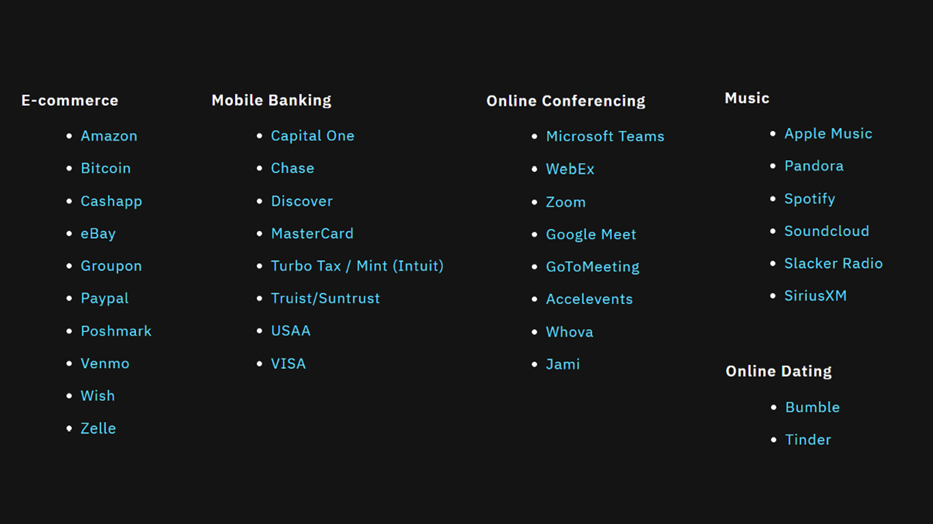
TAKE CONTROL OF YOUR DATA
MANAGE YOUR PRIVACY SETTINGS
https://staysafeonline.org/resources/manage-your-privacy-settings/

Slide 14
TAKE CONTROL OF YOUR DATA
Protect Your Data
Passwords
Phishing
Create long, unique passwords and store them in a password manager
Recognize and report phishing
MFA
Update
Enable multi-factor authentication
Update software

Slide 15
03
How to Get Involved

Slide 16
RESOURCES
Become a Champion
Show your support for Data Privacy Week
Becoming a Champion is easy and free
Receive a toolkit of materials exclusively for registered Champions
Organizations: Get your company name listed on staysafeonline.org
Be among the first to receive updates on Data Privacy Week news, events and materials
https://staysafeonline.org/programs/data-privacy-week/dpw-champion/

Slide 17
Thank you
TO OUR 300+ REGISTERED CHAMPIONS!

Slide 18
HOW TO GET INVOLVED
Become a Champion
Sign your company up as a Champion: As a champion you receive a toolkit of these free resources
A PDF guide to Data Privacy Week and ways to get involved
>
Sample social media posts and graphics
>
Logos and Champion badges
>
Video call backgrounds
>
A sample press release
>
A sample email for employees
>
Posters
>
Tip Sheets
>

Slide 19
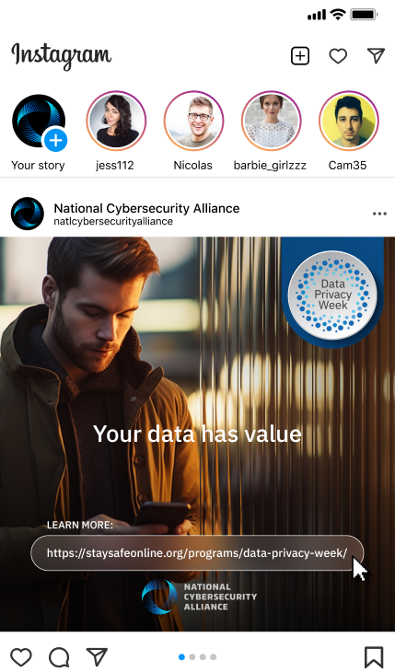
HOW TO GET INVOLVED
Become a Champion
Sign your company up as a Champion: As a champion you receive a toolkit of these free resources
A PDF guide to Data Privacy Week and ways to get involved
>
Sample social media posts and graphics
>
Logos and Champion badges
>
Video call backgrounds
>
A sample press release
>
A sample email for employees
>
Posters
>
Tip Sheets
>

Slide 20
HOW TO GET INVOLVED
Become a Champion
Sign your company up as a Champion: As a champion you receive a toolkit of these free resources
A PDF guide to Data Privacy Week and ways to get involved
>
Sample social media posts and graphics
>
Logos and Champion badges
>
Video call backgrounds
>
A sample press release
>
A sample email for employees
>
Posters
>
Tip Sheets
>

Slide 21
HOW TO GET INVOLVED
Become a Champion
Sign your company up as a Champion: As a champion you receive a toolkit of these free resources
A PDF guide to Data Privacy Week and ways to get involved
>
Sample social media posts and graphics
>
Logos and Champion badges
>
Video call backgrounds
>
A sample press release
>
A sample email for employees
>
Posters
>
Tip Sheets
>

Slide 22
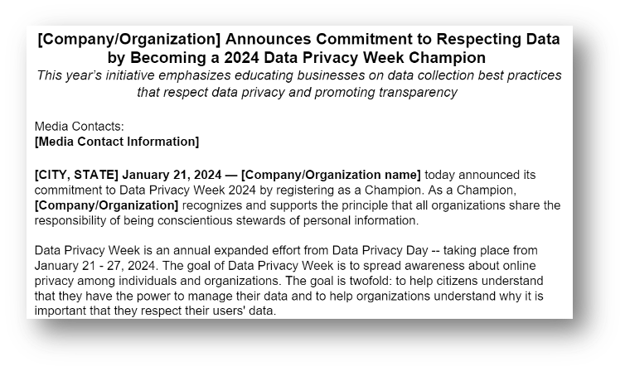
HOW TO GET INVOLVED
Become a Champion
Sign your company up as a Champion: As a champion you receive a toolkit of these free resources
A PDF guide to Data Privacy Week and ways to get involved
>
Sample social media posts and graphics
>
Logos and Champion badges
>
Video call backgrounds
>
A sample press release
>
A sample email for employees
>
Posters
>
Tip Sheets
>

Slide 23
HOW TO GET INVOLVED
Become a Champion
Sign your company up as a Champion: As a champion you receive a toolkit of these free resources
A PDF guide to Data Privacy Week and ways to get involved
>
Sample social media posts and graphics
>
Logos and Champion badges
>
Video call backgrounds
>
A sample press release
>
A sample email for employees
>
Posters
>
Tip Sheets
>

Slide 24
HOW TO GET INVOLVED
Become a Champion
Sign your company up as a Champion: As a champion you receive a toolkit of these free resources
A PDF guide to Data Privacy Week and ways to get involved
>
Sample social media posts and graphics
>
Logos and Champion badges
>
Video call backgrounds
>
A sample press release
>
A sample email for employees
>
Posters
>
Tip Sheets
>

Slide 25
HOW TO GET INVOLVED
At Work
Post the logo
Post to intranet site
Send an email
Host a virtual or in-person training
Launch a quiz
Issue a company promotion

Slide 26
HOW TO GET INVOLVED
At Home
Sign up for our newsletter
Talk to your kids
Review the privacy and security settings with members of your family

Slide 27
HOW TO GET INVOLVED
On Social Media
Post privacy tips
Use #DataPrivacyWeek
Use our sample social media posts and graphics

Slide 28
HOW TO GET INVOLVED
In Your Community
Teach others about how to manage and secure their data.
Use our Online Safety Volunteer toolkit and videos: https://staysafeonline.org/programs/cybersecurity-awareness-month/teach-others-how-to-stay-safe-online/
Share additional resources as takeaways

Slide 29
01
Actionable
HOW TO GET INVOLVED
Talking About Data Privacy
02
Positive
Be…
03
Empowering
04
Simple
05
Realistic

Slide 30
04
Upcoming Events

Slide 31
TALKING DATA
DAILY CONVERSATIONS ABOUT KEEPING YOUR DATA PRIVATE AND SAFE!
January 22 — 26, 2024
Notes:
Midday Eastern time​
Topics: Children's Privacy, Privacy Legislation, Data Brokers and Consumer Reports' Permission Slip​

Slide 32
05
Additional Resources

Slide 33
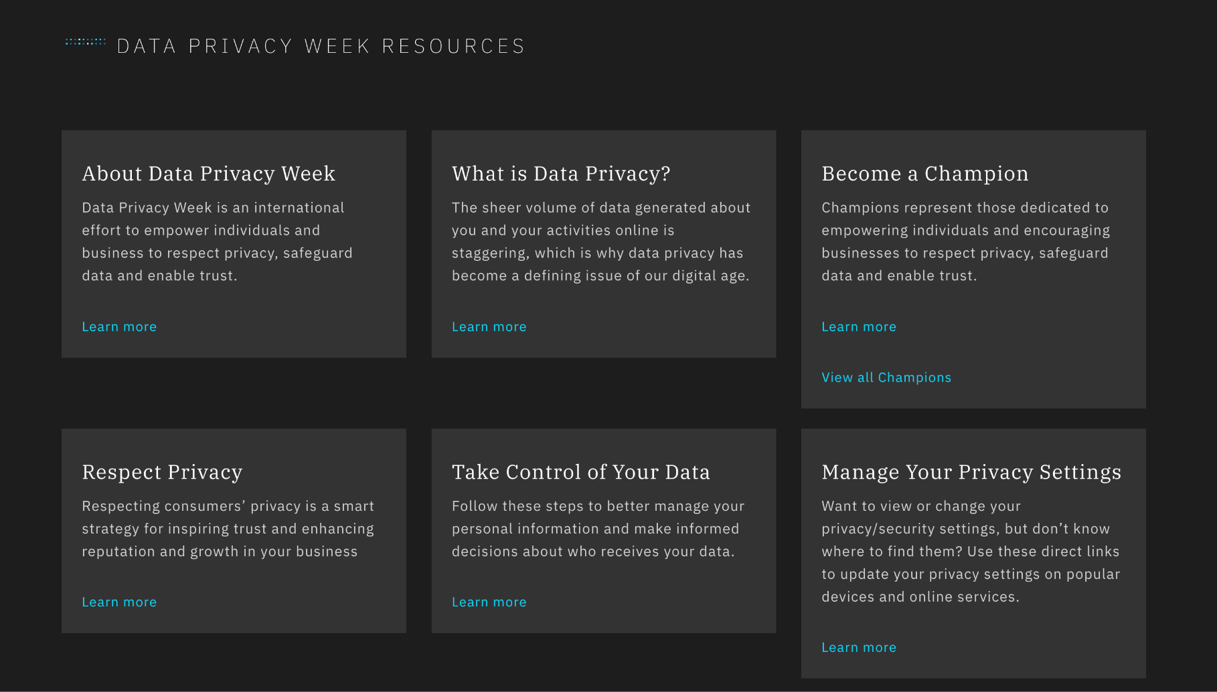
ADDITIONAL RESOURCES
For more information
ON DATA PRIVACY WEEK:
National Cybersecurity Alliance https://staysafeonline.org/programs/data-privacy-week/

Slide 34
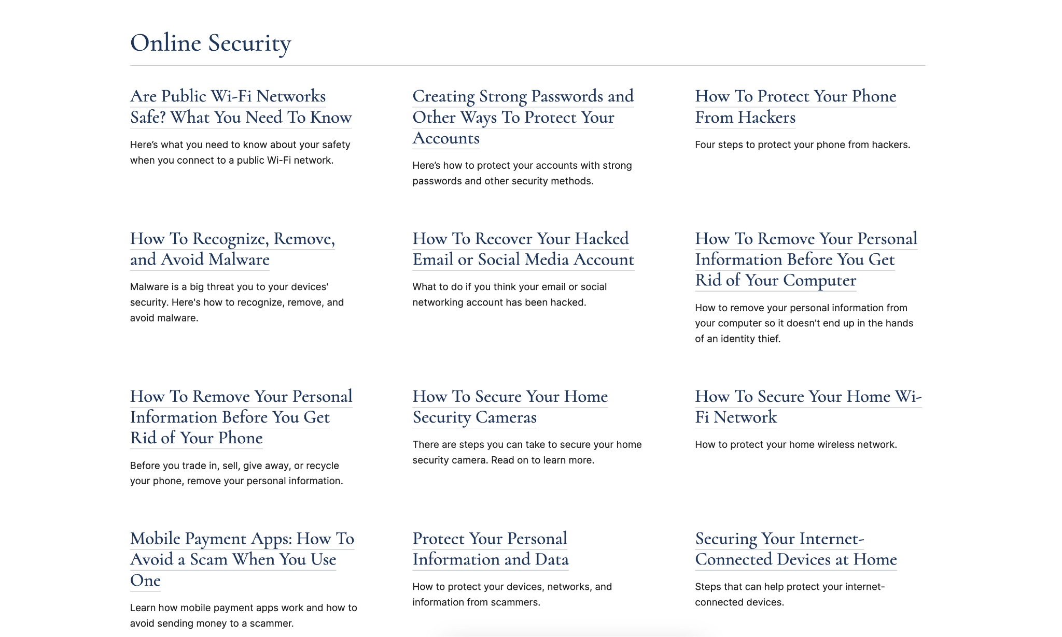
ADDITIONAL RESOURCES
For more advice
ON PRIVACY AND SECURITY:
Federal Trade Commission https://consumer.ftc.gov/identity-theft-and-online-security/online-privacy-and-security
EN ESPAÑOL:
Federal Trade Commission https://consumidor.ftc.gov/robo-de-identidad-y-seguridad-en-linea/privacidad-y-seguridad-en-linea

Slide 35
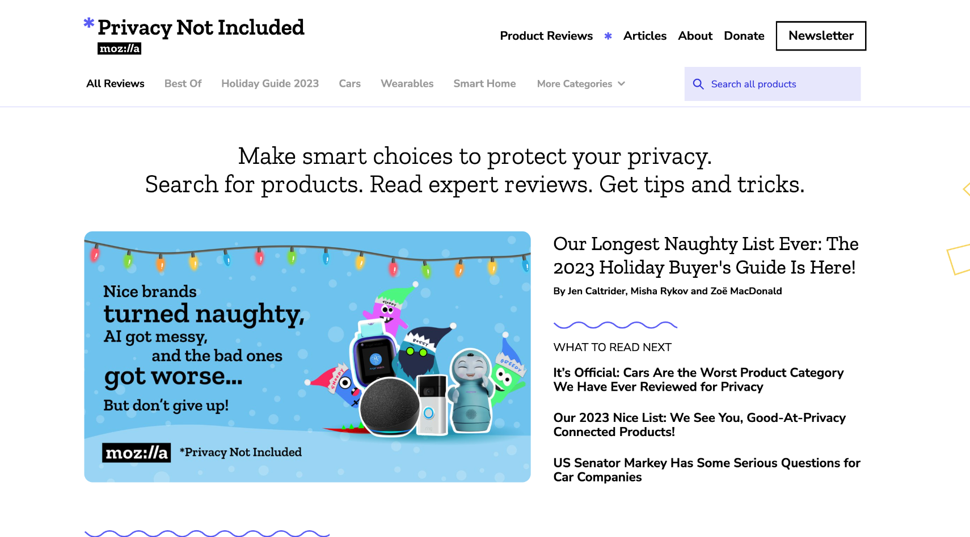
ADDITIONAL RESOURCES
For privacy information
ON CONNECTED DEVICES:
Mozilla *Privacy Not Included https://foundation.mozilla.org/en/privacynotincluded/

Slide 36
ADDITIONAL RESOURCES
For privacy
professionals
International Association of Privacy Professionals (IAPP) https://iapp.org/store/knowledgenets/

Slide 37
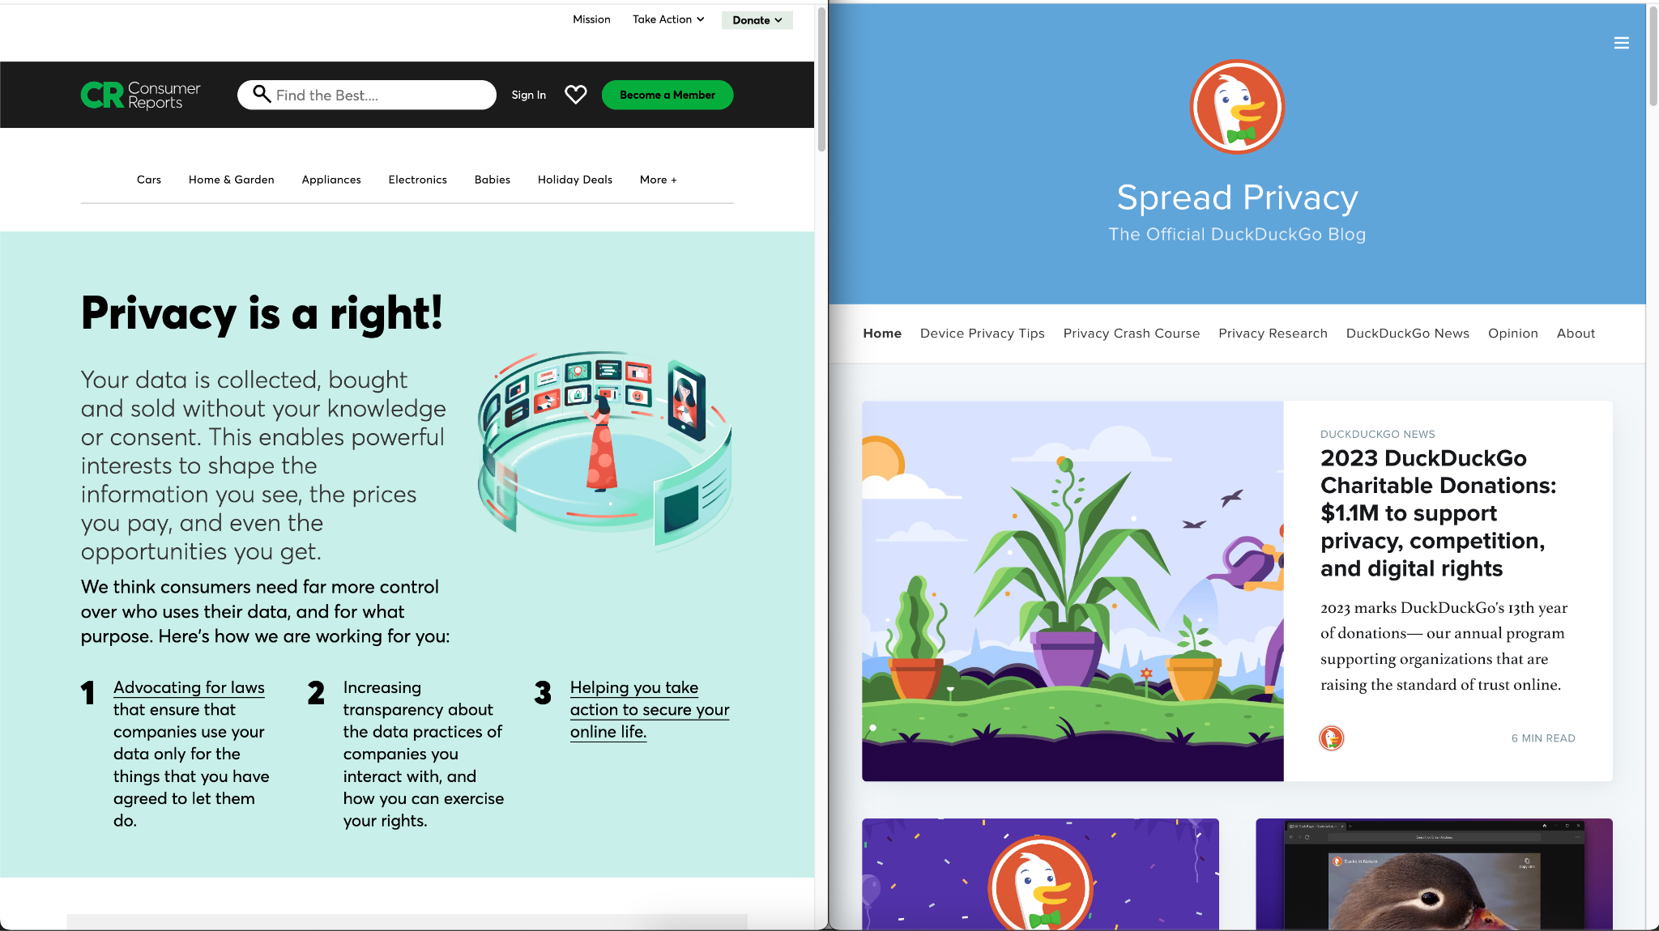
ADDITIONAL RESOURCES
For the latest privacy news
Consumer Reports https://www.consumerreports.org/issue/data-privacy
DuckDuckGo https://spreadprivacy.com/

Slide 38
Sponsorships are still available!
Please contact Lucas@staysafeonline.org for more information

Slide 39
Website
StaySafeOnline.org
Twitter
@staysafeonline
Facebook
/staysafeonline
LinkedIn
/national-cyber-security-alliance
Instagram
natlcybersecurityalliance
Email
info@staysafeonline.org

